Slide 1
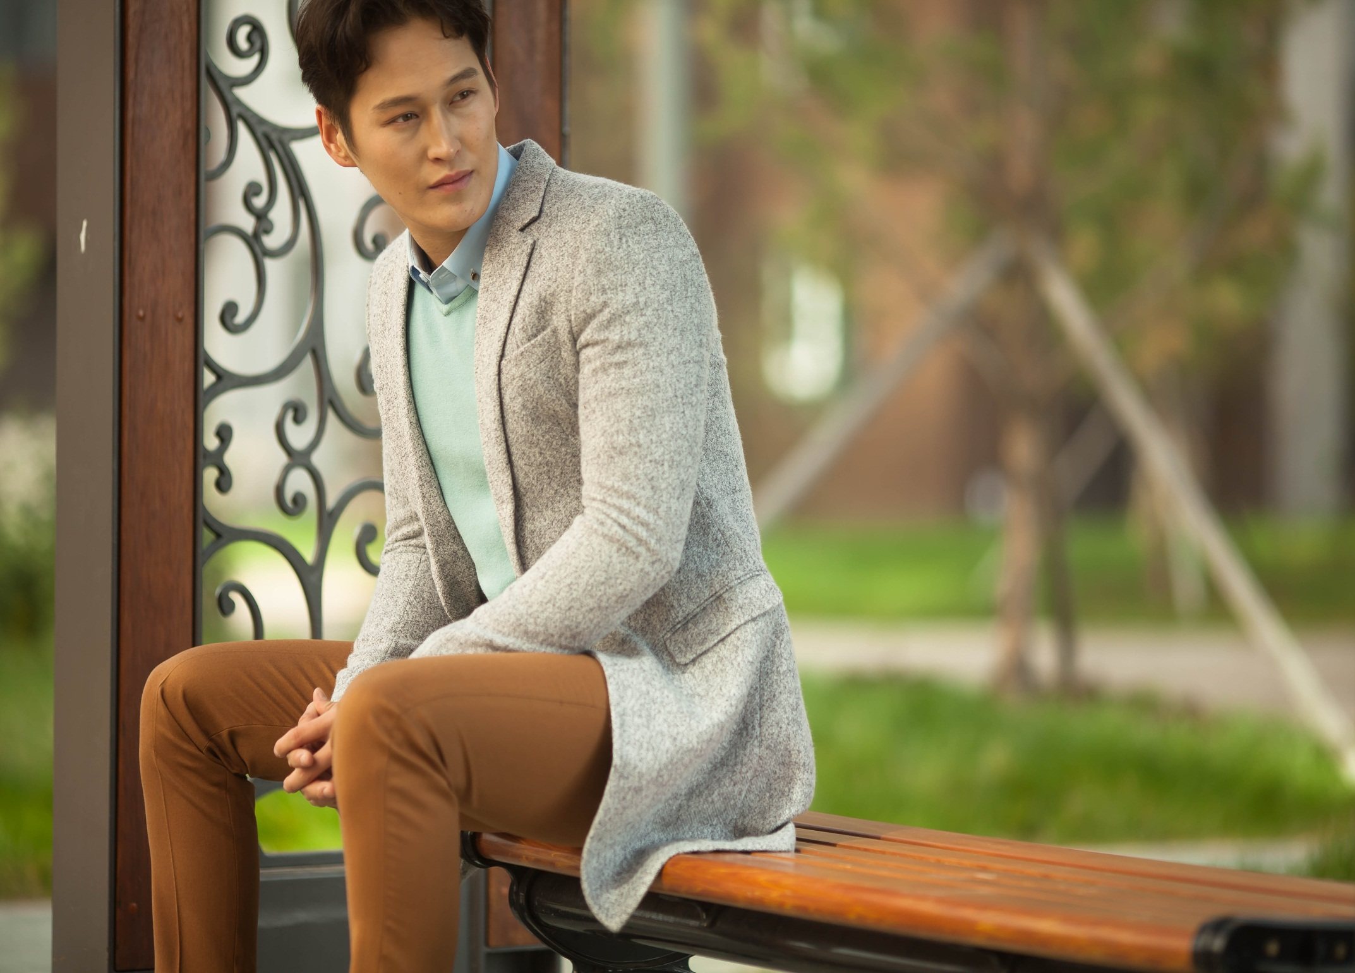
Profile - Mongolian Art Textile
November, 2018
Mongolia

Slide 2
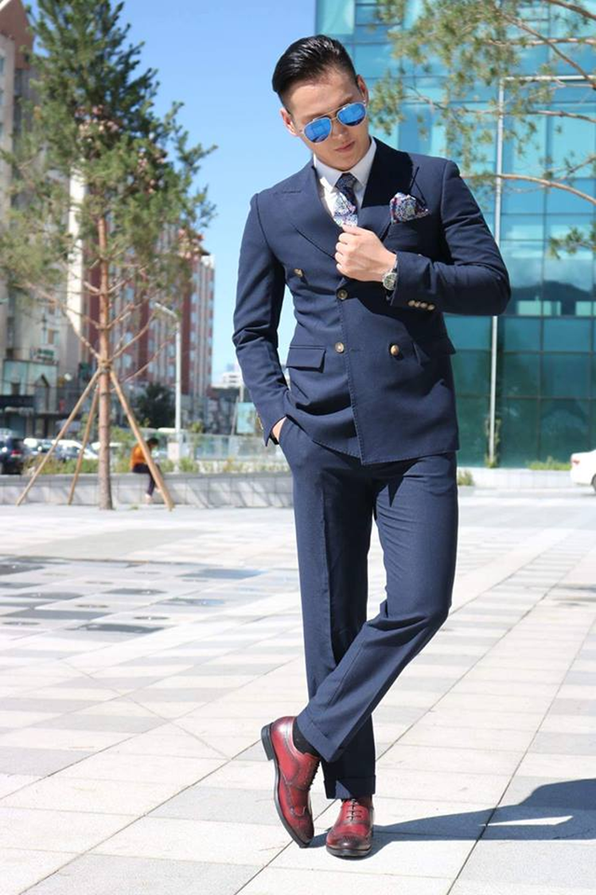
Our profile

Slide 3
Profile
Mongolian Art Textile is a vertically integrated retailer
and a fast fashion leader in Mongolia.
01
02
03
04
Sales
Manufacturing
Global brand
Brand development
Men
Women
Kids
Shoes
Guyug
Fast fashion
Homeware
Margad
Nomadica
The Bank
Monartex design, produce and sell fashion apparel and accessories both for adults (men, women and shoes) under The Bank, Fashion Club, Ginza, Uncage, Catwalk and Guyug stores.

Slide 4
Strategy
Vision:
Being an industry-leading, national-best supplier
Mission:
Being a market-leading and world reference company
OUR VISION
Values:
Customer satisfaction
Team power
Responsibility
Growth

Slide 5
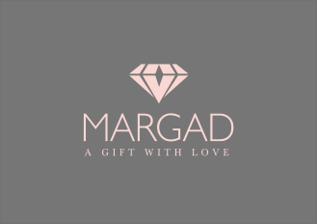
Org structure
Shareholders
Board of Directors
Chief Executive Officer
Internal auditor
Finance
Department
Sales & Marketing Department
HR & Administration Department
Product Development Department
The Bank
Guyug
Global brand
Margad

Slide 6
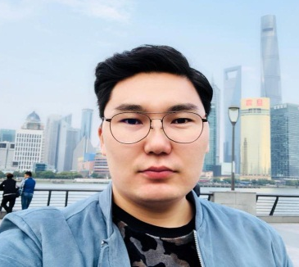
Key personnel
Management
Company Management Team
Ken
Altantugs
Bayarsaikhan
Nyam
Ivshin-khorol
Baatar
2007-2010 - BSc on Business administration, La Trobe University, Vietnam
2006-2010 BSc on Finance & economist, National University of Mongolia
2015-2017 – MBA on Lawyer, National University of Mongolia
1999-2003 - BSc on Business administration, Zokhiomj University, Mongolia
2014-2016 - MBA on Financial management, University of Finance & Economics, Mongolia
2012-2014 – Program Manager, Habitat for Humanity Mongolia
2014-current – Co-founder & Chief Executive Officer, Mongolian Art Textile
2010-2014– Head of Planning & Economy Department, Namir Group
2012-2013 – Advisor, Ministry of Finance, World Bank Project
2014-current – Co-founder & Chief Financial Officer, Mongolian Art Textile
2003-2009 - Operations Manager, Tridum LLC
2010-2017 – Chief Executive Officer, Montermo LLC
2017-current – General Manager, Mongolian Art Textile

Slide 7
Highlights
5 years experience
5 brand
stores
Over 40 employees
700m2
warehouse
1,500 SKU of products
15,000 VIP customers
30% average growth yearly

Slide 8
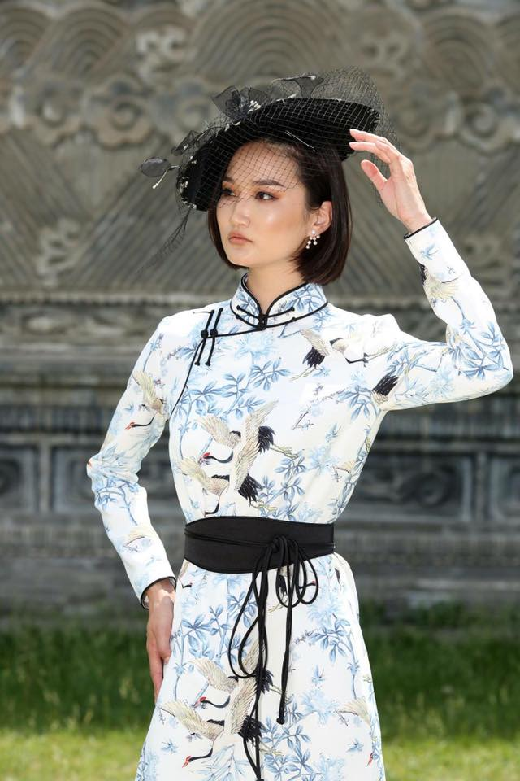
Our product range

Slide 9
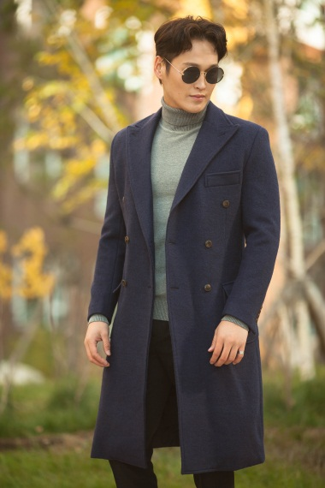
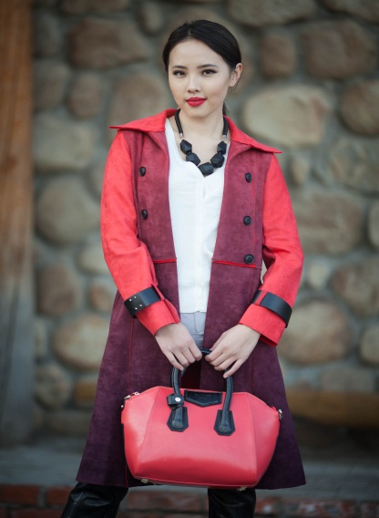
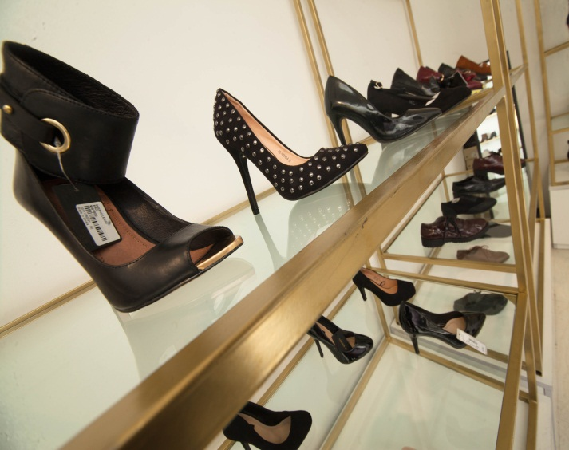
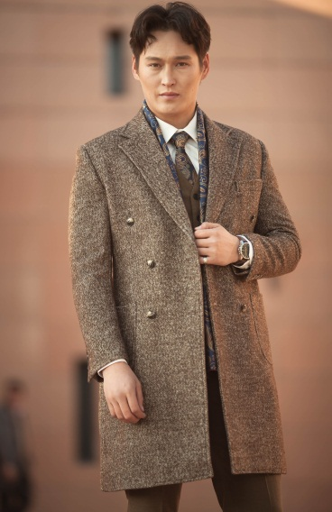
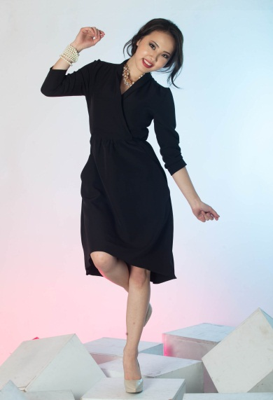
Retailer
Men
Women
Shoes
Classic
Casual
Street styles
Ceremony clothing

Slide 10
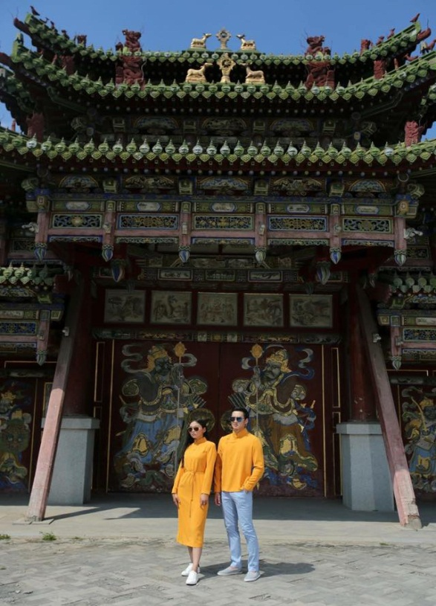
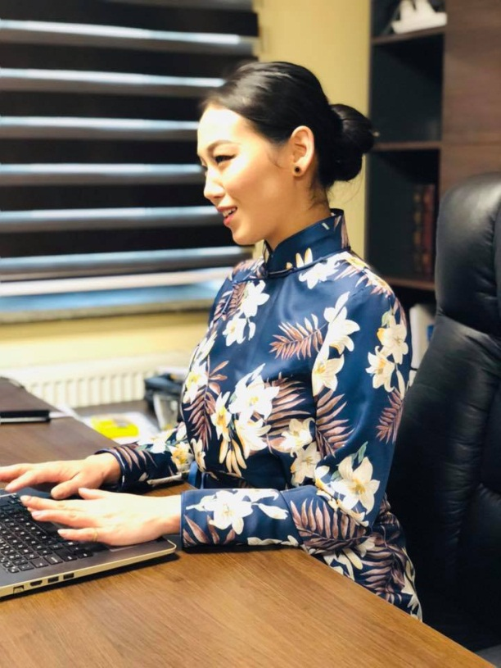
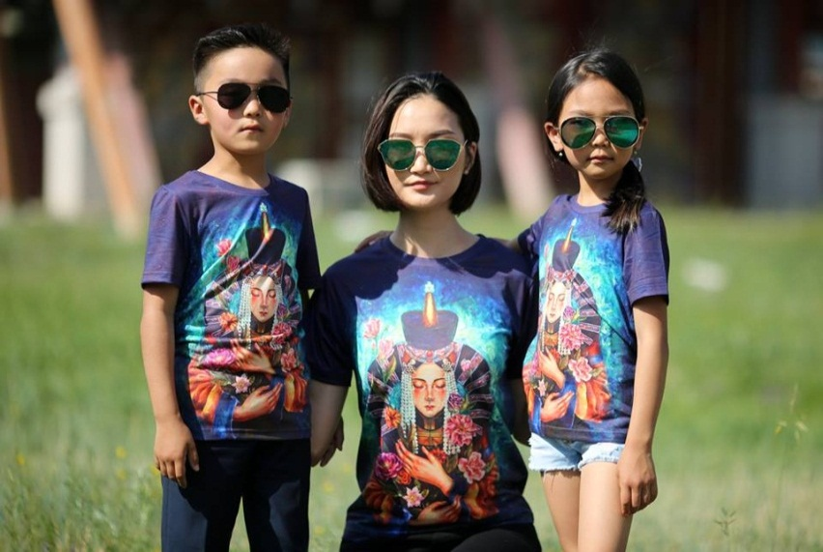
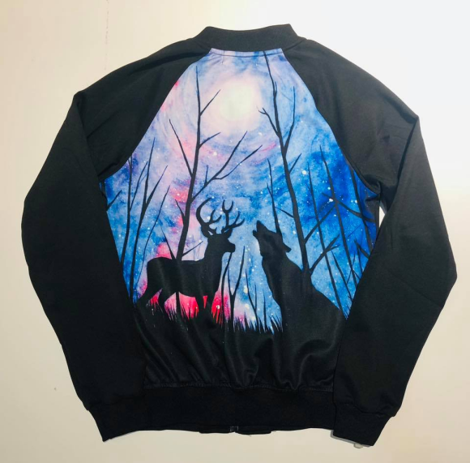
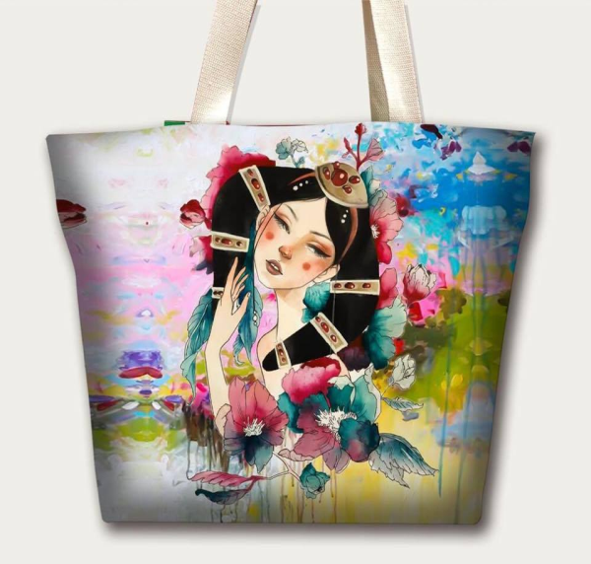
Manufacturer

Slide 11
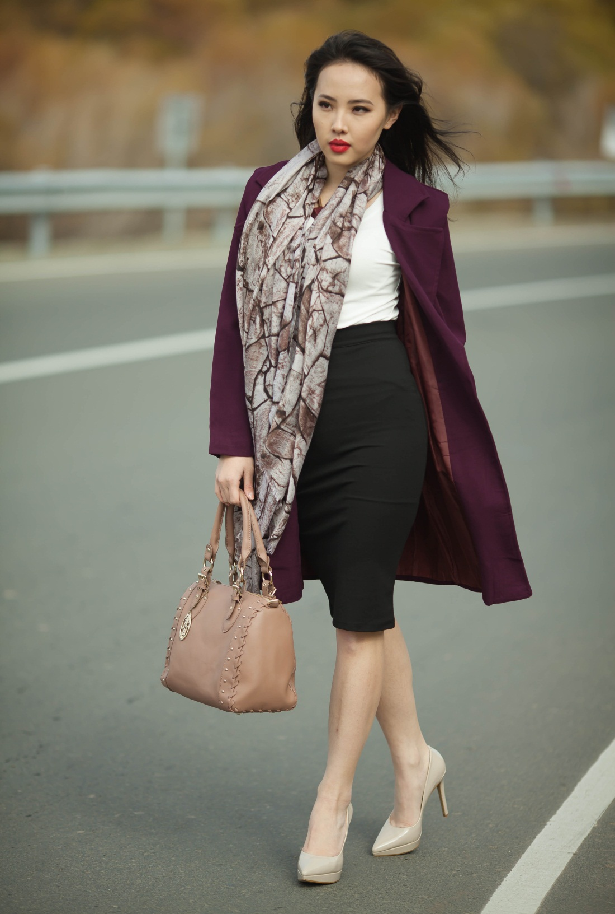
Our retail stores

Slide 12
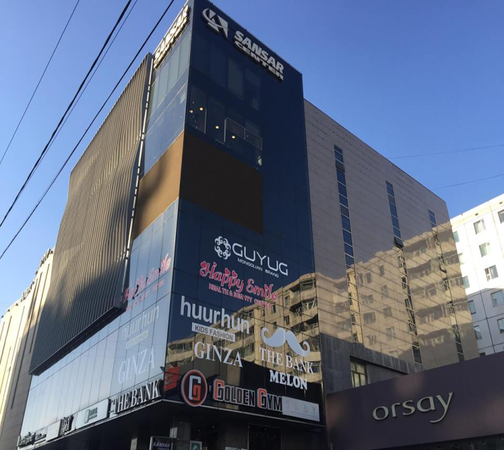
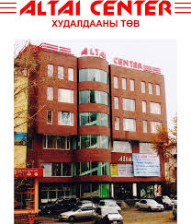
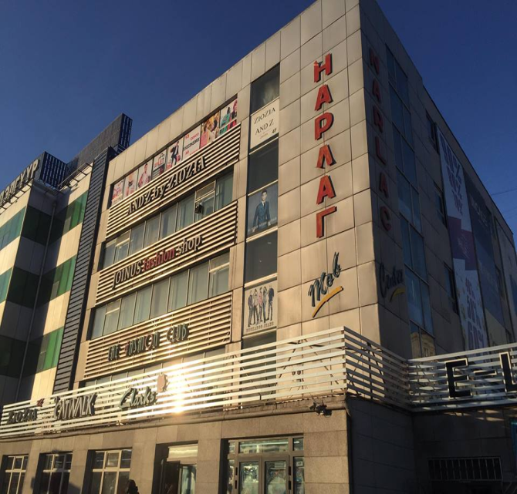
Retail stores
Monartex have 7 retail stores on 3 shopping malls
Sansar Center
Altai Center
Narlag Center
900 m2
400 m2
450 m2
The Bank – 450 m2
Uncage – 150 m2
Ginza – 150 m2
Guyug – 150 m2
Guyug – 400 m2
Fashion club – 350 m2
Catwalk – 100 m2

Slide 13
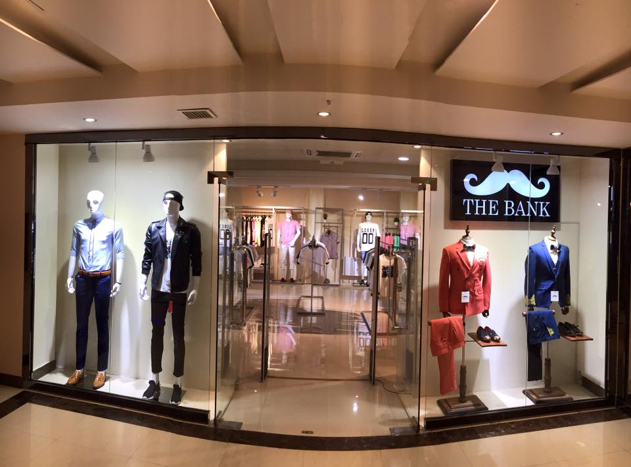
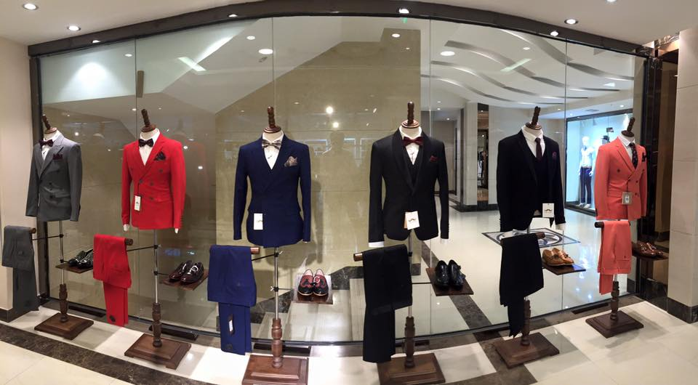
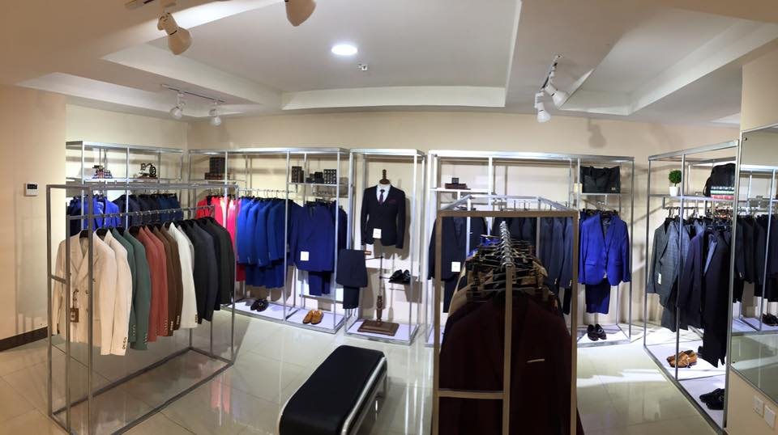
The Bank (Classic)

Slide 14
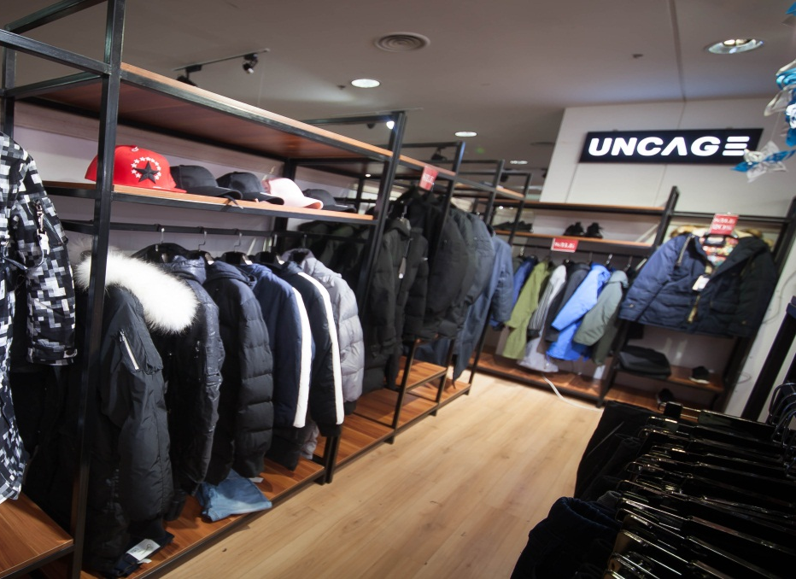
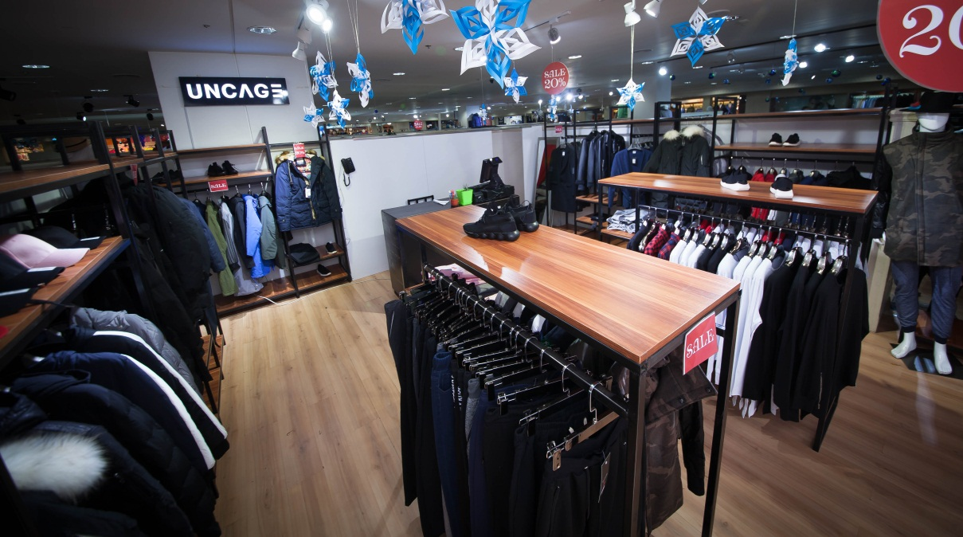
Uncage (Street style)

Slide 15
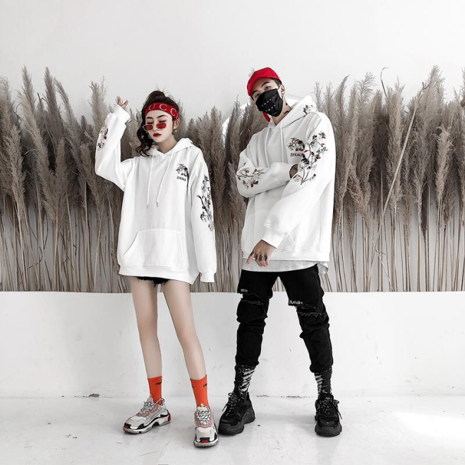
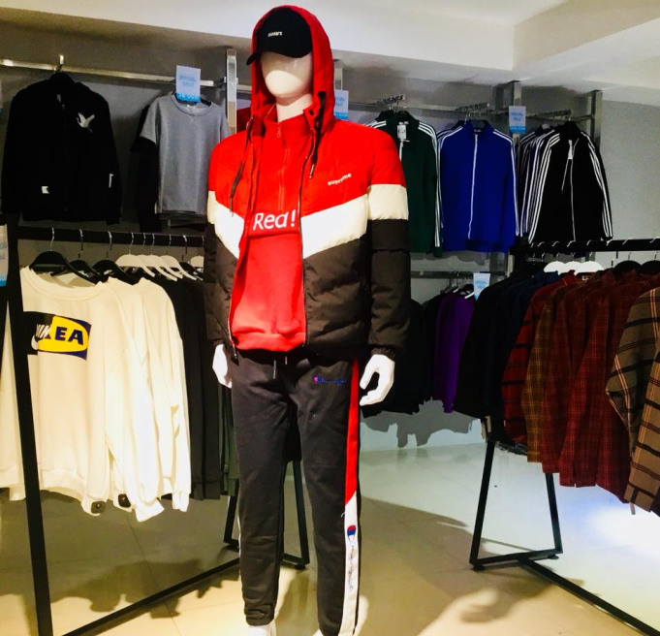
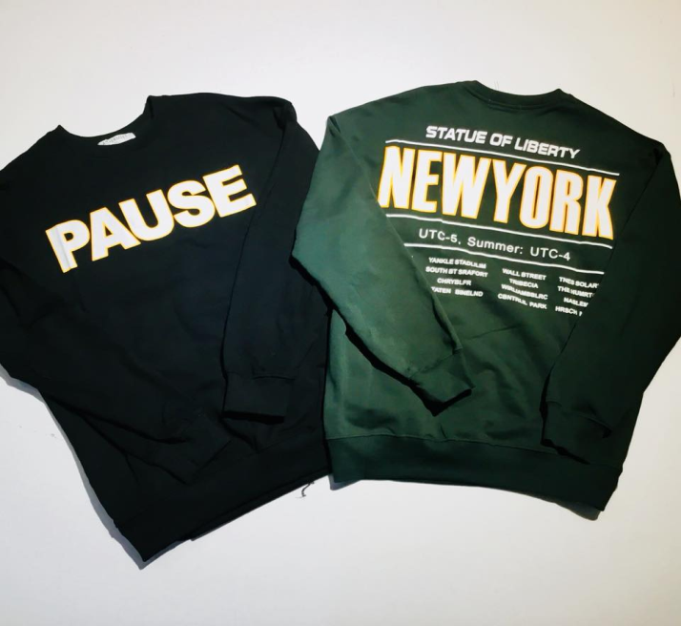
Ginza (Japanese style)

Slide 16
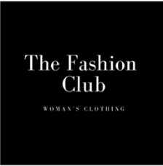
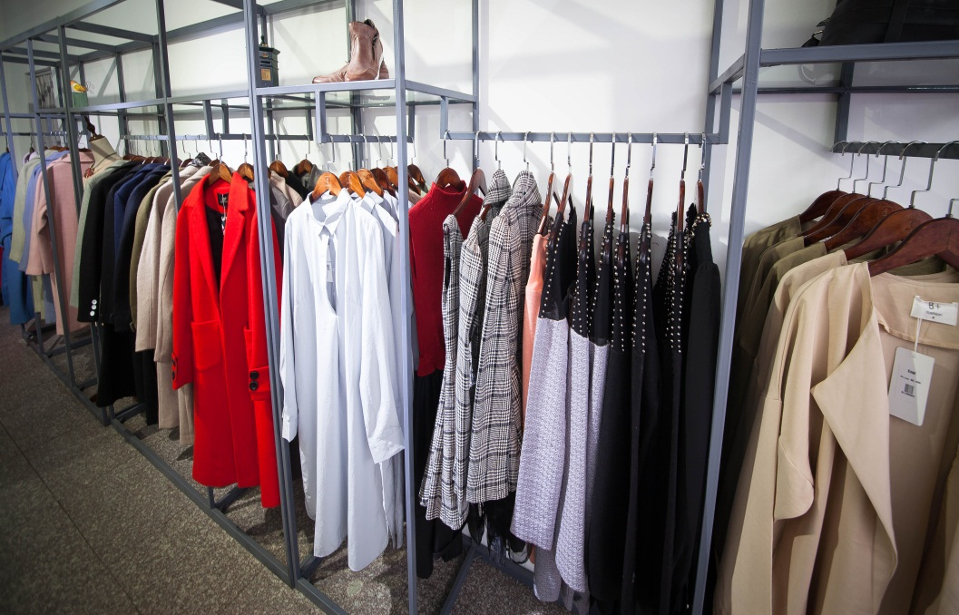
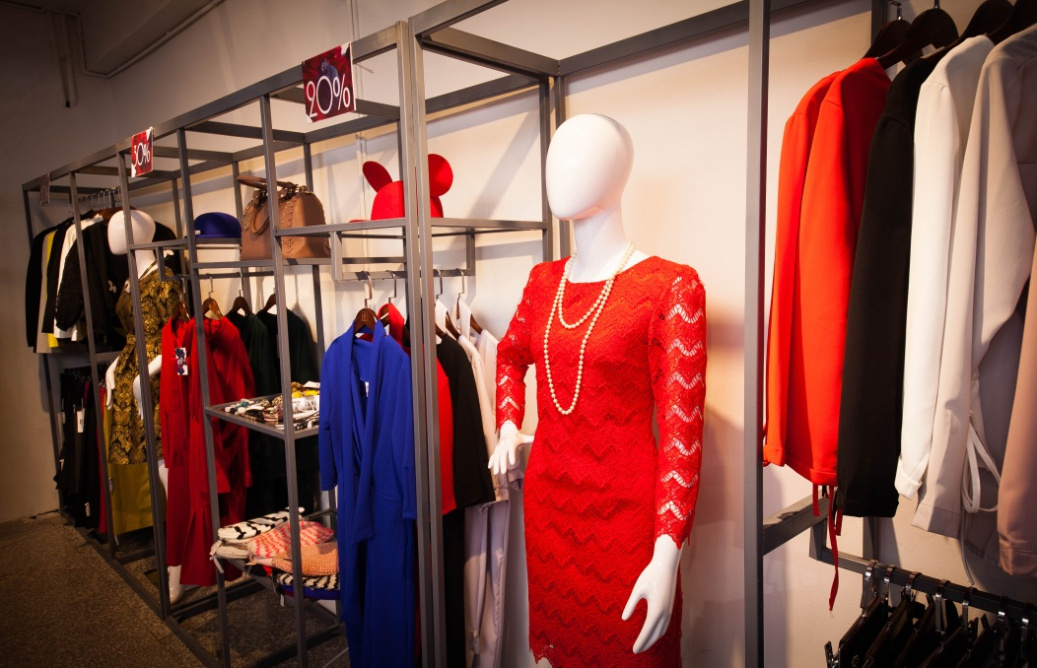
Fashion club (Casual)

Slide 17
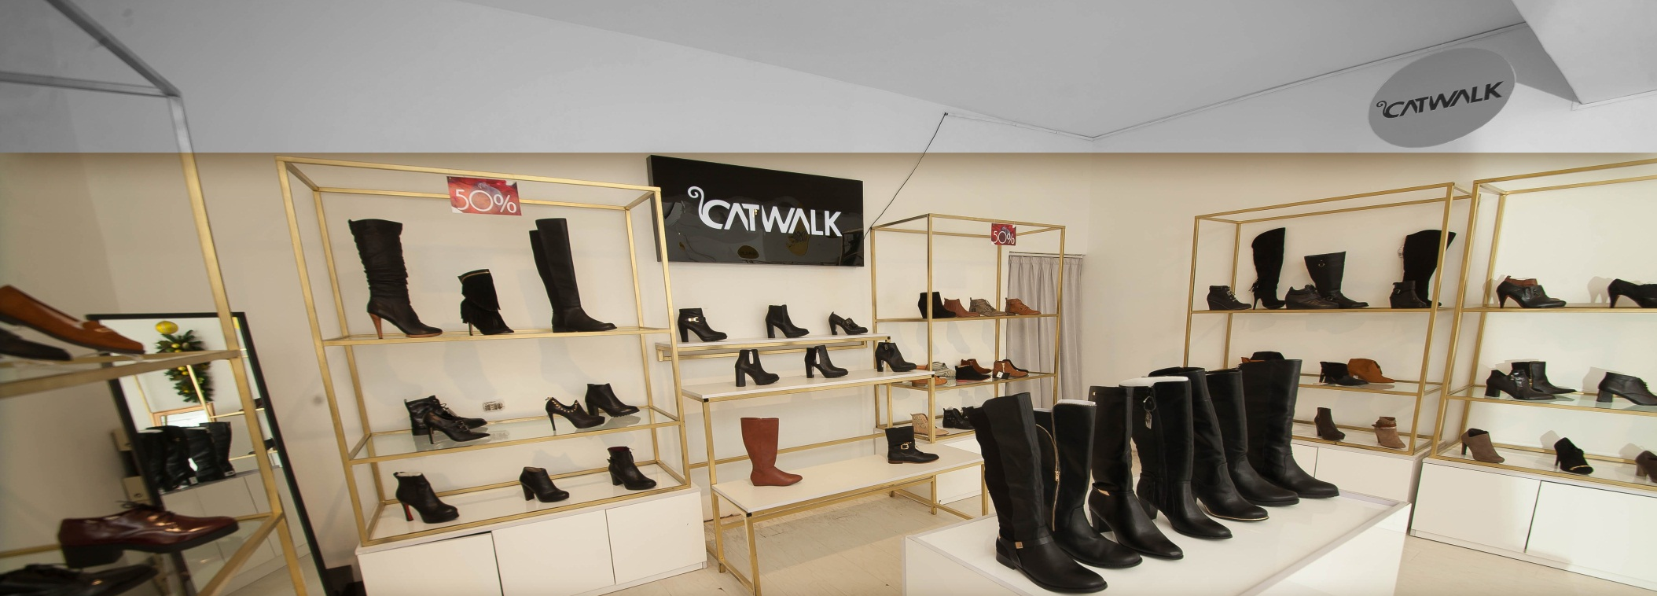
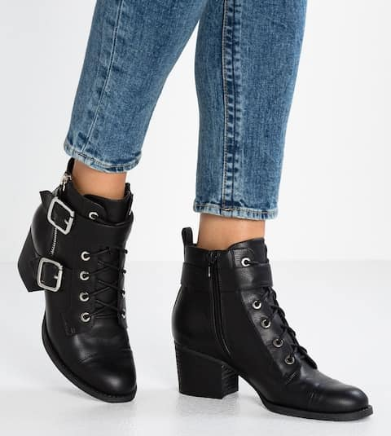
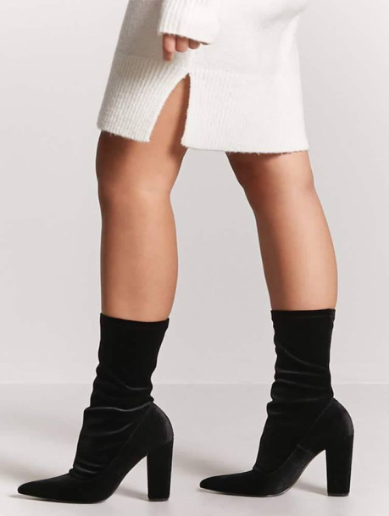
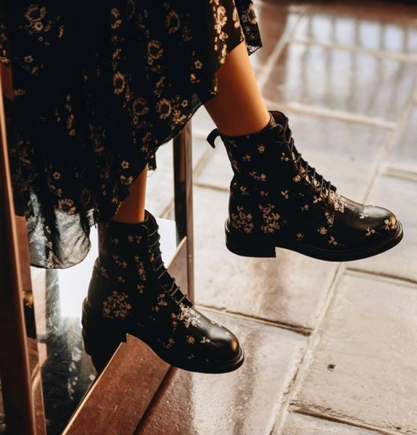
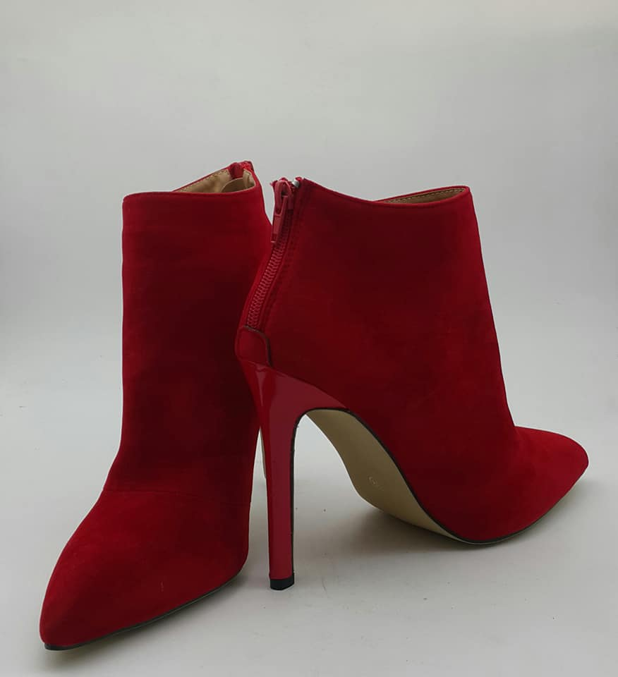
Catwalk (Shoes)

Slide 18
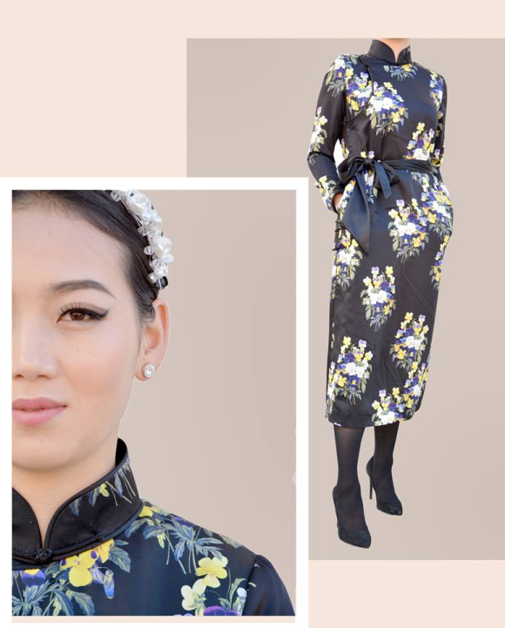
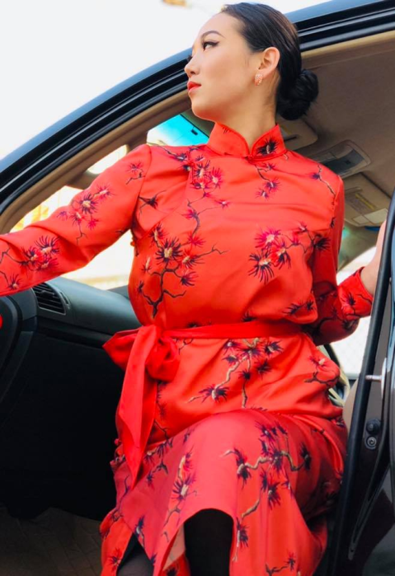
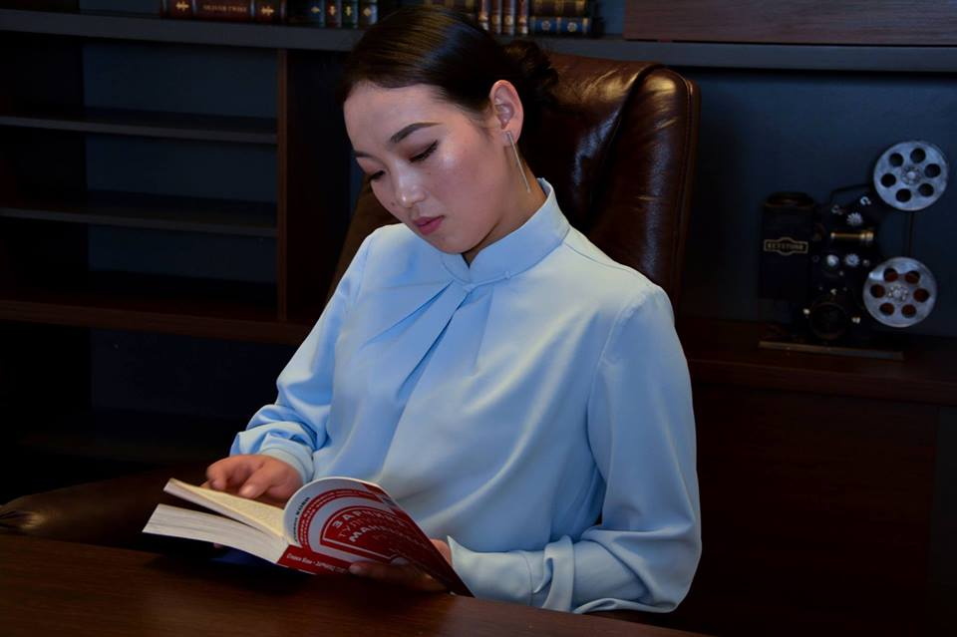
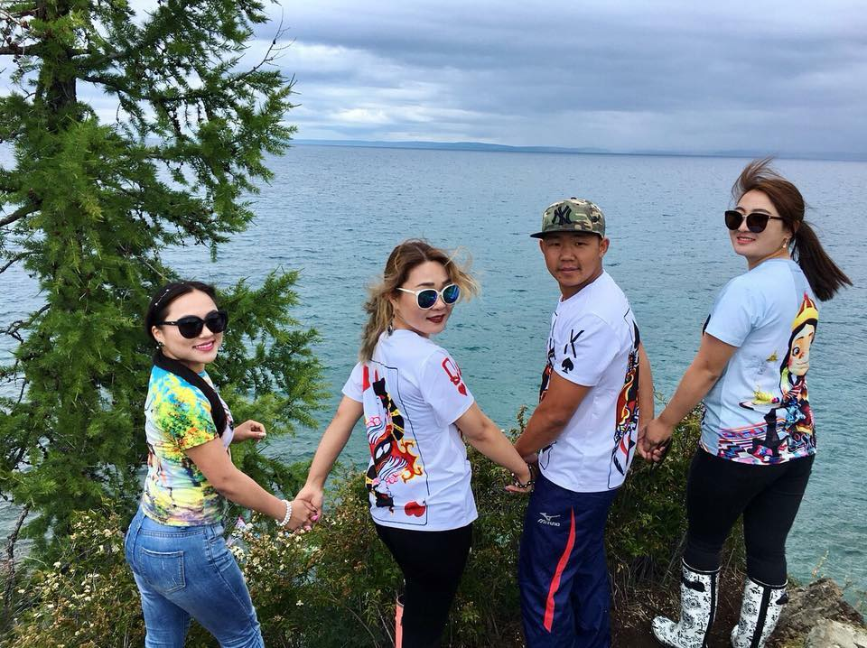
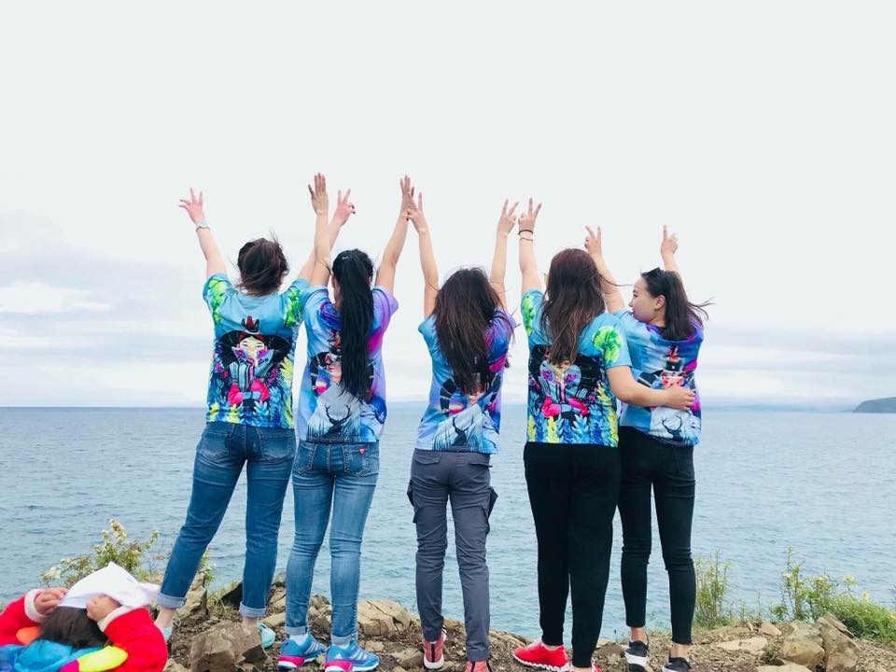
Guyug (National clothing)

Slide 19
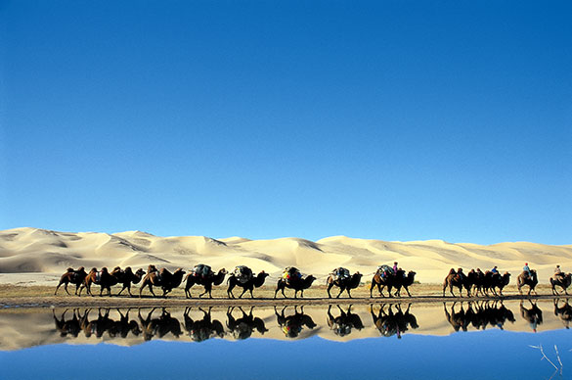
Thank you for your attention!
Please contact us:
sales@monartex.mn

